Slide 1

App Design Basics
The important stuff
Steven King
UNC jSchool
@steven_king

Slide 2
An App is a tool not art.
It is a usable, helpful tool for accomplishing a task or solving a problem.
But it should look good!
So, answer these two questions:

Slide 3
1. What problem does the app solve? (use)
2. Who will use the app?
(user)

Slide 4
How will the user use the app?
Call this user/use

Slide 5

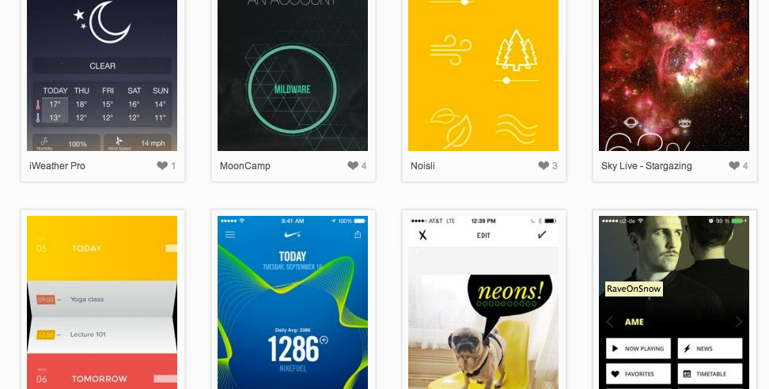
Basics to follow
Good things to keep in mind.

Slide 6

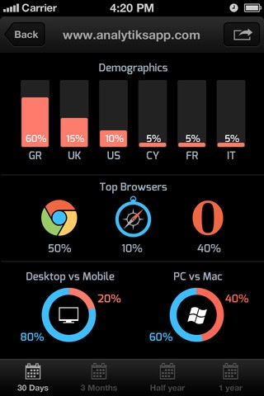
Focus on task and content
DO NOT port content from one platform to another.
Have a purpose

Slide 7
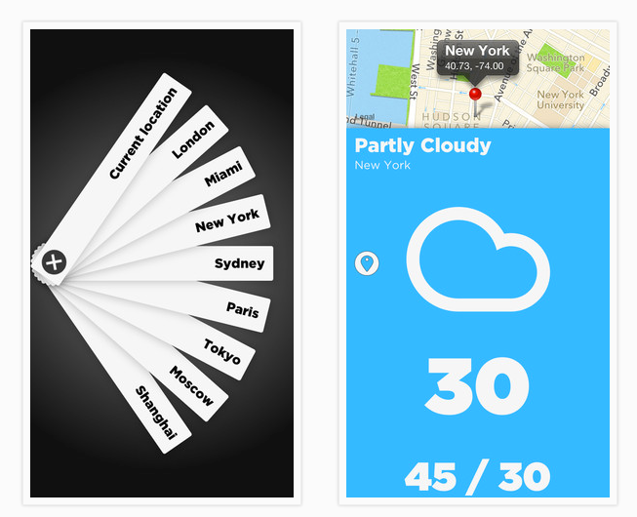
Take advantage of mobile
What is specific to mobile?
Why is mobile best?
What tools can I use?

Slide 8

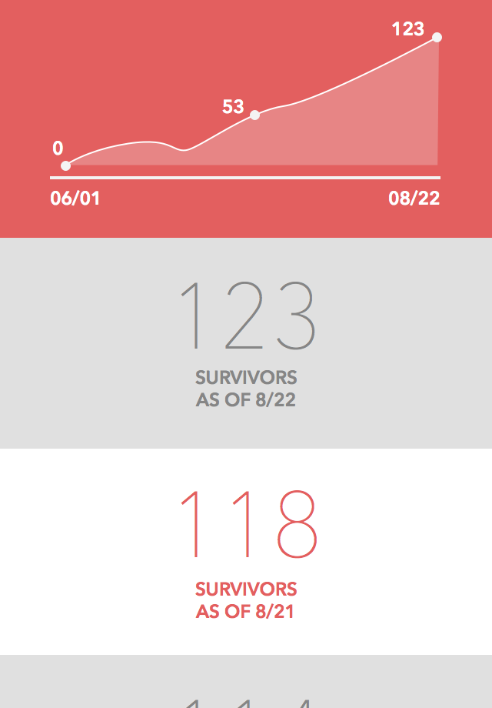
Design for accessibility
Don’t forget about the purpose of the app.
Sizes, important information, etc.

Slide 9
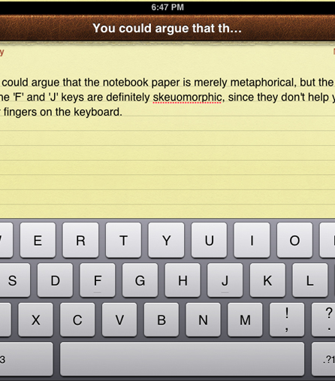
Carful with Skeuomorphism
Skeuomorphism refers to a design principle in which design cues are taken from the physical world.
Carful, people might not understand your metaphor

Slide 10
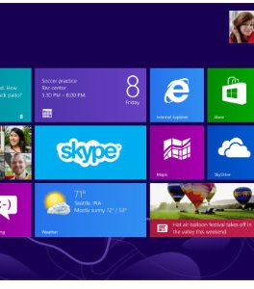
Carful with Flat Design
Removes stylistic choices that give the illusion of 3D (drop shadows, gradients, or textures) and is focused on a minimalist use of simple elements

Slide 11
Entertainment vs. Utility
User/Use

Slide 12
Entertainment or Utility?
Both?

Slide 13
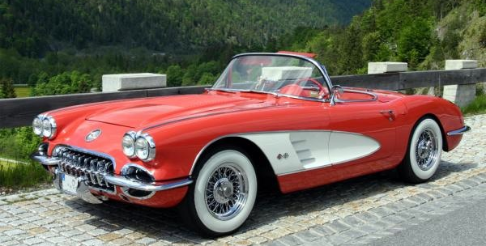
Trends Trend
But good design lives forever

